Slide 1
By- Ranajay Biswas
Supervised ML - Classification
Email Campaign Effectiveness Prediction

Slide 2
Content :
Introduction
Objectives & Problem Statement
Data Summary and Attributes
Exploratory Data Analysis
Data Cleaning
Pre-Processing & Feature Engineering
Modelling
Feature Importance Evaluation
Hyper parameter Tuning
Conclusion

Slide 3

Introduction - What is the Email Campaign?
Email campaign is a sequence of marketing efforts that contacts multiple recipients at once. Email campaigns are designed to reach out to subscribers at the best time and provide valuable content and relevant offers. Using email campaigns allows businesses to build deep and trusting relationships with their customers.
Marketing through Email can make communication with clients easier and more effective.
Email campaigns are a very powerful medium between a business company and it's audience. It helps not only to increase sales but build brand image.

Slide 4
Objectives that can be accomplished by Email Marketing :
Emails help nurture leads: Each new lead requires nurturing before making his/her first purchase. The task of the marketing team is to provide them with the right educational materials. They include how-to guides, live demos, workshops, webinars, useful checklists, tutorials, etc. Each email will make a user move down the sales funnel. Predict all possible pain points that a user may face when dealing with the brand and eliminate them.
Emails help keep customers engaged: Now it’s getting much harder to stir users’ interest in a brand. So, one has to come up with new formats and new offers. Email is just the place for experiments. Via this channel, important information can be shared, expertise can be showcased, and the businesses can offer exclusive deals.
With emails, you can collect data about subscribers: To provide every user with an individual approach or get an idea about similar users, information needs to be collected about them. With an email campaign, this task is as easy as pie. All that is needed is to ask subscribers to share some important data to craft more targeted and personalized offers. Then, dividing all the list into segments, the businesses can send relevant content to each group.
Emails help convert: With all this information about the clients, unique promotions can be created for each user. Tracking their interactions with the brand, it is easy to know their favorite products and buying habits — this will help send emails triggered by clients’ actions. As a result, email performance and sales will increase.
Emails help your business improve: Asking clients for feedback is important. Can be done right after the purchase or on a regular basis via a survey. It's helpful to find out what customers appreciate the most about the brand, which difficulties they face, and what they would improve.

Slide 5

Problem Statement :
Most of the small to medium business owners are making effective use of Gmail-based Email marketing Strategies for offline targeting of converting their prospective customers into leads so that they stay with them in business.
The main objective is to create a machine learning model to characterize the mail and track the mail that is ignored; read; acknowledged by the reader.
Approach :
Performing Exploratory data analysis will help us understand the features and relationships that they have and their impact on the target or the client's response. We will try to find out important features and we will do feature engineering.
Data is labeled and the target column being categorical, we shall implement classification based machine learning algorithms to complete the prediction task.
Data Summary & Attributes :
The Email campaign data contains various types of information regarding the emails that were sent, it contains info about their customers and their responses. Checking the shape of the data, we found that it has 68353 observations and 12 columns.

Slide 6
Attributes:
Email Id - It contains the email id's of the customers/individuals.
Email Type - There are two categories 1 and 2. We can think of them as marketing emails or important updates, notices like emails regarding the business.
Subject Hotness Score - It is the email's subject's score on the basis of how good and effective the content is.
Email Source - It represents the source of the email like sales and marketing or important admin mails related to the product.
Email Campaign Type - The campaign type of the email.
Total Past Communications - This column contains the total previous mails from the same source, the number of communications had.
Customer Location - Contains demographical data of the customer, the location where the customer resides.
Time Email sent Category - It has three categories 1,2 and 3; the time of the day when the email was sent, we can think of it as morning, evening and night time slots.
Word Count - The number of words contained in the email.
Total links - Number of links in the email.
Total Images - Number of images in the email.
Email Status - Our target variable which contains whether the mail was ignored, read, acknowledged by the reader.

Slide 7
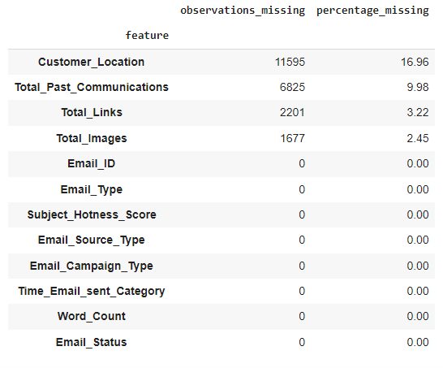
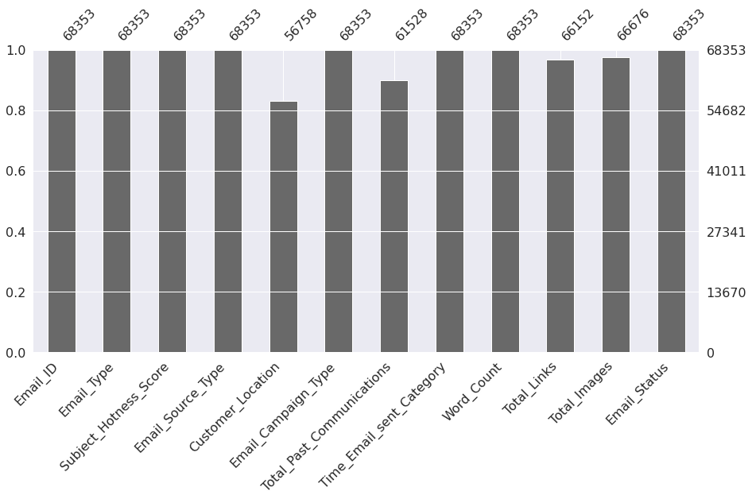
Exploratory Data Analysis :
Exploratory Data Analysis is unavoidable and one of the major step to fine-tune the given data set(s) in a different form of analysis to understand the insights and the key characteristics of various entities of the data set like column(s), row(s) by applying Pandas, NumPy, Statistical Methods, and Data visualization packages.
Checking Null Values : Customer Location, Total Past Communications, Total Links & Total Images columns were the numerical columns that have null values.

Slide 8
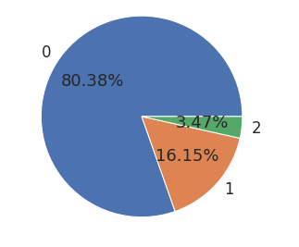
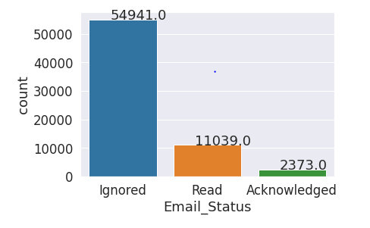
EDA Continued…
Class Label Distribution of Dependent Variable :
Dependent variable or target is the column that is going to be predicted by our machine learning models. In our case, that is the Email Status column.
Class labels for the target column is highly imbalanced. Only 3.5% of total sent emails were acknowledged. 16% were read and more than 80% were ignored.

Slide 9
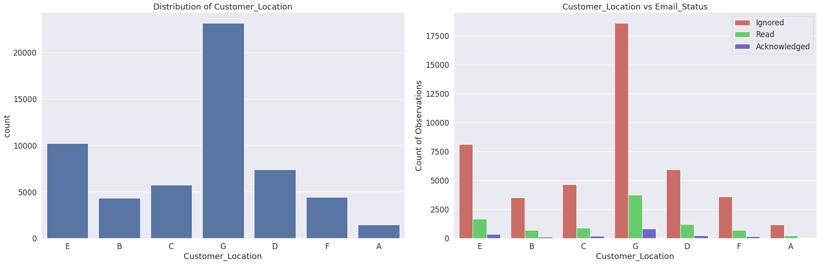
Analysis of Categorical features:
We have 5 categorical columns in the data, which are – ‘Email Type’, ‘Email Source Type’, ‘Customer Location’, ‘Email Campaign Type’, ‘Time Email sent Category’.
As we can see, regardless of the demographic, the class label distribution for the dependent column is similar. So, it can be said that 'Customer Location' does not have any strong relationship with the client's response or the 'Email Status' column.

Slide 10
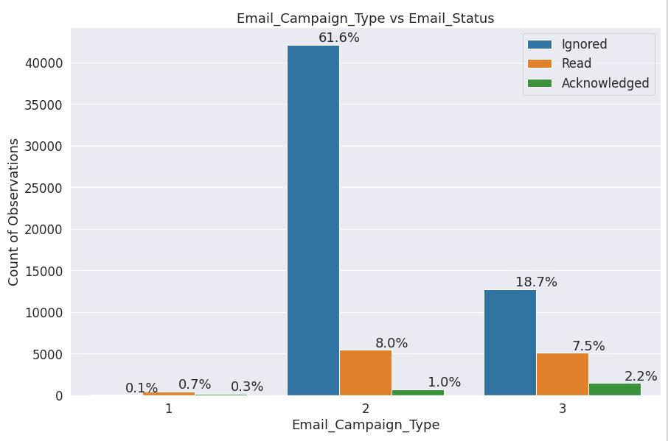
EDA Continued…
From the Email Campaign Type column, we can see -
Among the 3 different Email Campaign Types, type1 has been sent the least (close to 1%)
Email campaign type 2 seems to have been sent the most and more than 60% percent of the ignored mails come from this category.

Slide 11
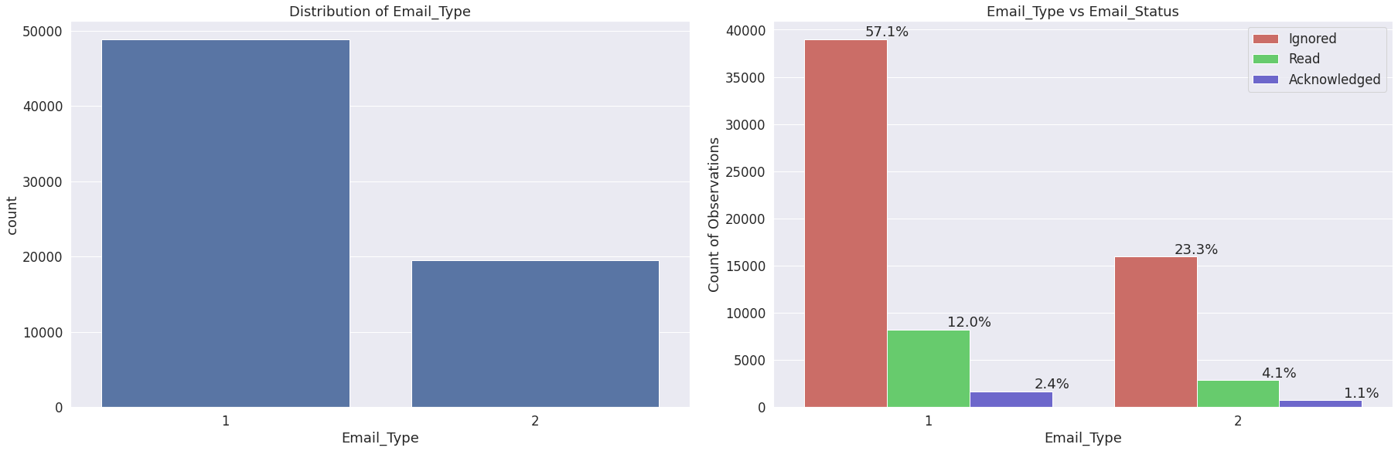
EDA Continued…
There are two categories 1 and 2 in Email Type column. We can think of them as marketing emails or important updates, notices like emails regarding the business.
Email Type 1 was sent to more clients compared to Type 2.

Slide 12
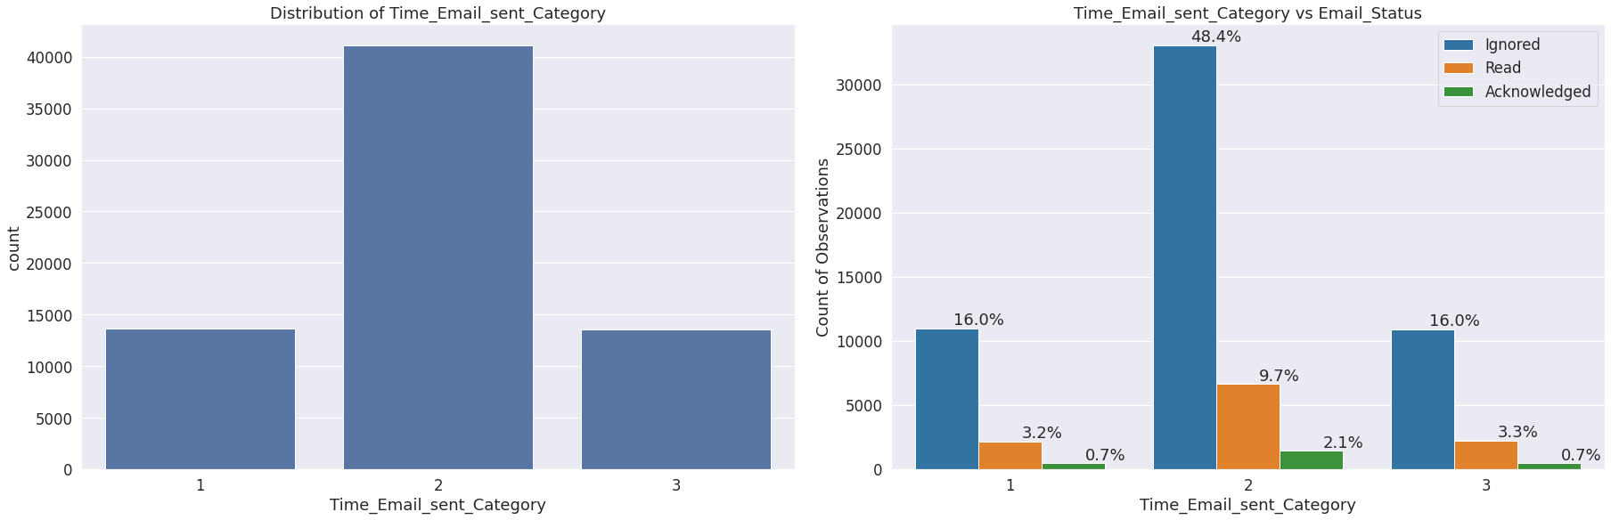
EDA Continued…
Time Email sent Category has three categories 1,2 and 3; the time of the day when the email was sent, we can think of it as morning, evening and night time slots.
More people received emails during the evening.
Though this feature does not seem to have much of an impact on the client's response.

Slide 13
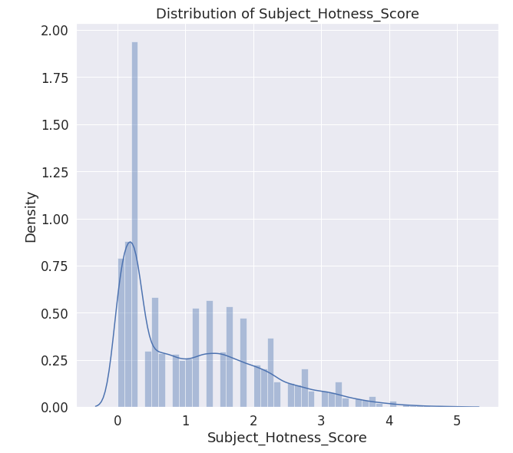
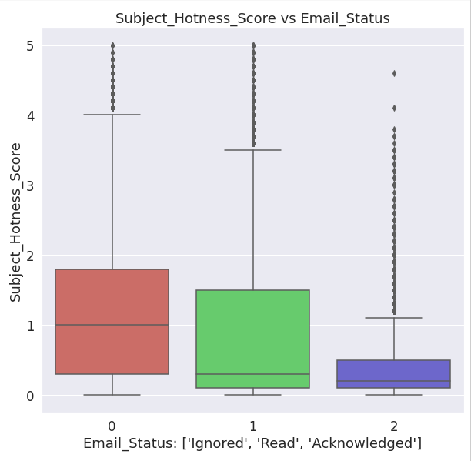
Analysis of Numerical columns :
The numerical columns in the data are : ‘Subject Hotness Score’, ‘Total Past Communications’, ‘Word Count’, ‘Total Links’, ‘Total Images’.
Subject Hotness Score is the email's subject's score on the basis of how good and effective the content is.
The feature is right skewed.
For all three class labels, it has outliers.

Slide 14
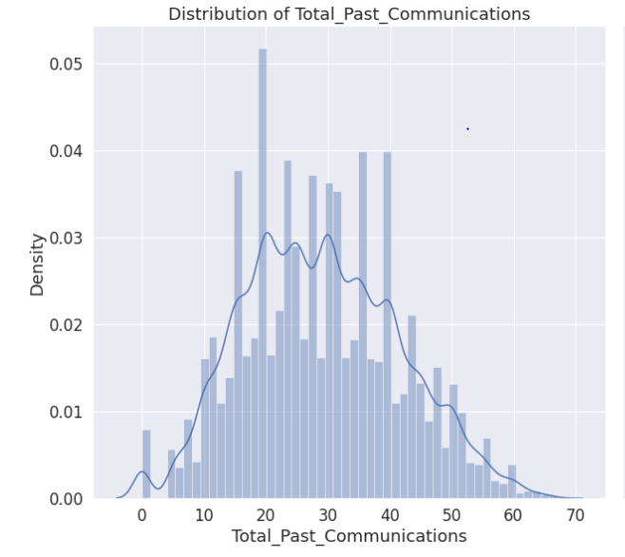
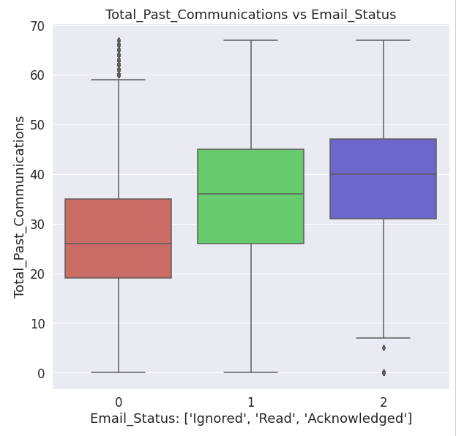
EDA Continued…
Total Past Communications column contains the total previous mails from the same source, the number of communications had.
The distribution is slightly positive skewed.
From the boxplots, we can see that more acknowledgements were received from the clients who were previously contacted more.

Slide 15
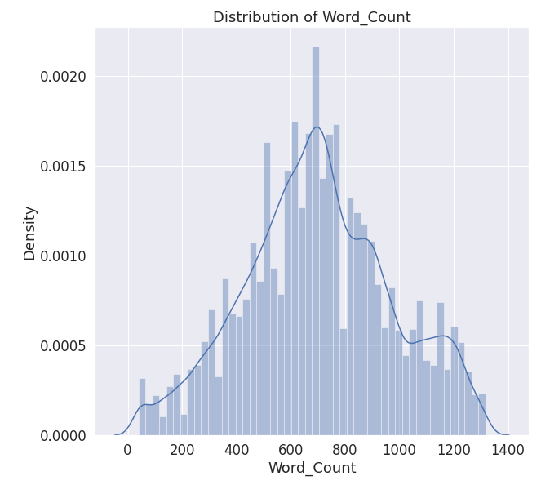
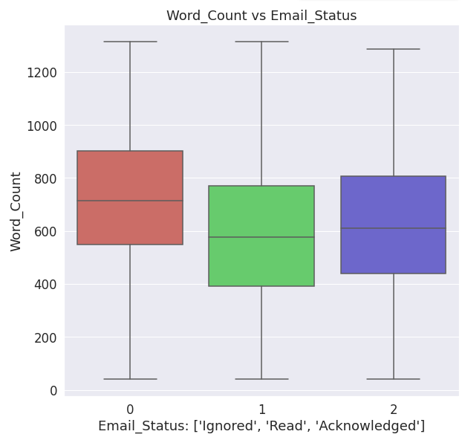
EDA Continued…
Word Count column contains the number of words in the email.
Distribution for this feature follows more like a normal distribution.

Slide 16
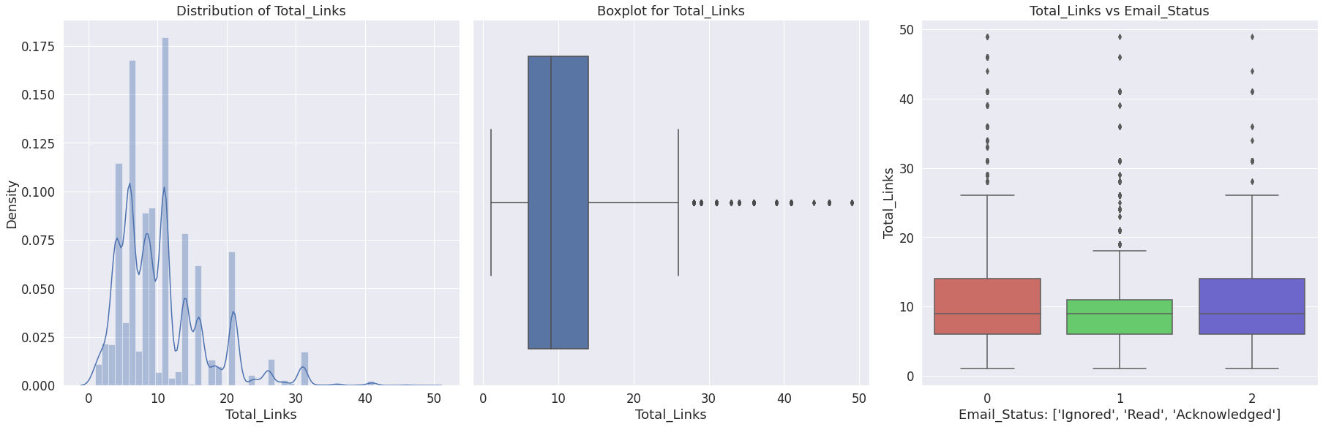
EDA Continued…
Total Links column gives us the idea of how many links were there in the email.
Positively skewed distribution.
Contains outliers for all three class labels.

Slide 17
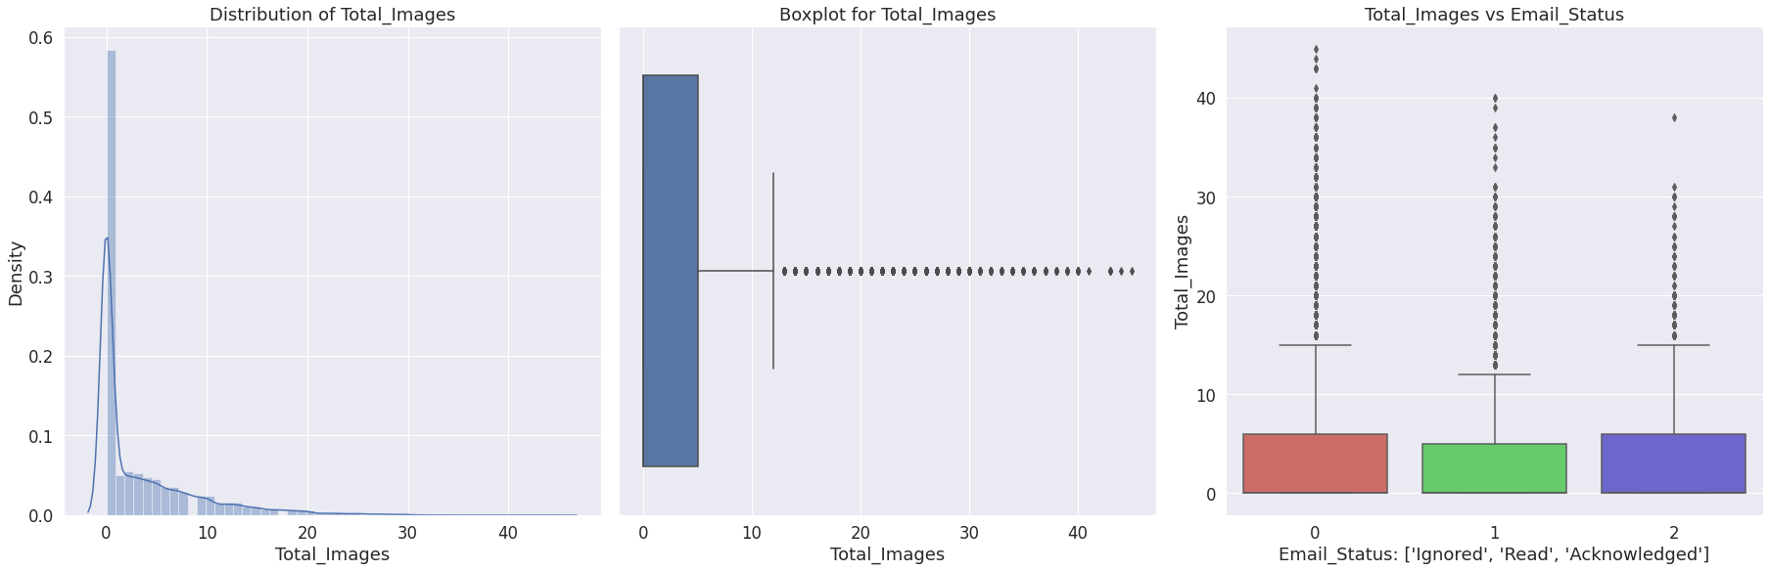
EDA Continued…
Total Images gives us the number of images in the email.
Highly skewed towards the positive side.
Outliers present for all the target classes.

Slide 18
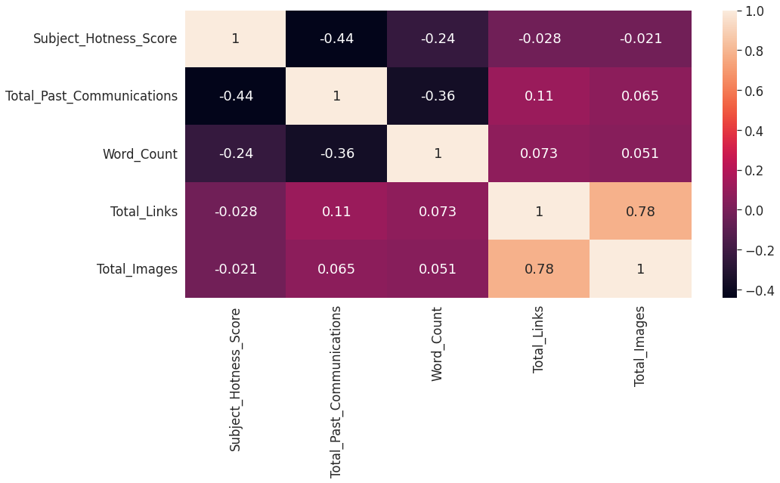
Checking for Multicollinearity :
Multicollinearity occurs when a change in an independent variable impacts one or more independent variables. Multicollinearity is a problem because it undermines the statistical significance of an independent variable.
Let’s check the correlation heat-map for the numeric features and see if there’s any multicollinearity in the data.
Total Images & Total Links are the most correlated features in the data. The correlation strength is 0.78
Total Past Communications & Subject Hotness Score share a negative correlation value of 0.44
Word Count & Total Past Communications have a moderate negative correlation of 0.36

Slide 19
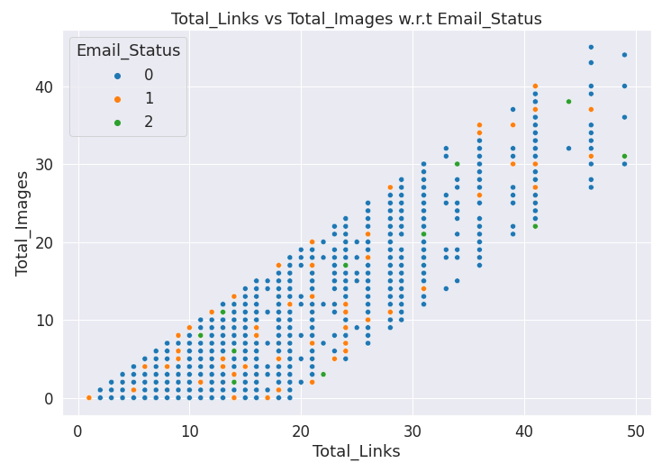
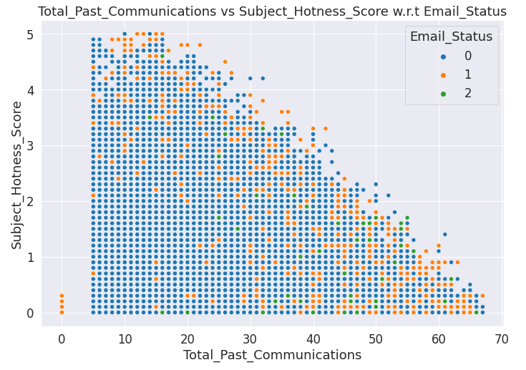
Visualizing Correlation :
The correlation between Total Images and Total Links is pretty high (0.78). We can combine these two features and make a new one to deal with this multicollinearity problem.
We can perform this step during the feature engineering part. But before that, we need to do data cleaning.

Slide 20
Data Cleaning :
Unimportant Features :
'Email ID' column is just an unique identifier for each observation. It is not helpful for any kind of modelling. So, we drop this column.
'Customer Location' column has the most number of missing values. And it being a categorical column, it is not easy to impute and we can not simply use mode imputation for this many large number of missing values. It was previously seen that this column is not really helpful for class differentiation & prediction. So, instead of imputing this large number of null values , we dropped this column.
Null Value Imputation : There were now 3 columns in the data with null values. We used MICE algorithm or the Iterative Imputation method for the null value imputation in these columns.
It is better than the general methods of mean or median imputation.
Outlier Detection : An outlier is usually a data point that differs significantly from other observations. In this project, we found the outliers using the IQR method for outlier detection.

Slide 21

Data Cleaning Continued…
Outlier Handling : The target column being highly imbalanced, we needed a better understanding of how the outliers were distributed for different classes.
So, we found the outliers for each class -
All the numeric columns except Word Count have outliers.
Minority classes also contain outliers, though in smaller numbers compared to the majority class.
'Total Images' have 8.28 percent and 'Total Links' have 2.42 percent outliers. 'Subject Hotness Score' and 'Total Past Communications' have 0.36 and 0.20 percent outliers respectively.
Since, we had more than enough data for majority class, we decided to drop the outliers only for those observations where the target is of majority class. Our data is imbalanced, so we do not want to lose any information about the minority classes.

Slide 22

Pre-Processing & Feature Engineering:
Feature creation : To avoid multicollinearity, we combined 'Total Links' and 'Total Images’ features and created a new feature and dropped the original features. The new feature is called Total link Images.
Encoding : On the categorical features, we performed one hot encoding so that they can be passed through the models.
Train-Test split : Train test split is the process of splitting dataset into 2 different parts. One part is used for training the model and other part is for testing the models performance. We performed train-test split with stratified sampling since dependent variable was imbalanced. 80 percent of data was used for training and 20 percent for testing.
Feature Scaling : We used mean max scaler for normalizing the data. This step might not be that necessary because we will be mostly using tree based and ensemble models. But performing this step doesn’t hurt.
Handling Imbalance : There are many techniques of handling class imbalance. The process that we followed were -

Slide 23

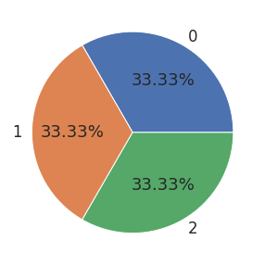
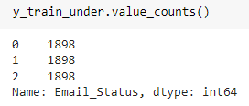
Undersampling :
Undersampling is a technique to balance uneven datasets by keeping all of the data in the minority class and decreasing the size of the majority class.
Though this process helps to bring balance, but we also lose a lot of information. This loss of information might affect models’ performances.
Shape of the training data X and Y after undersampling :
Distribution of class labels for training data after undersampling :

Slide 24
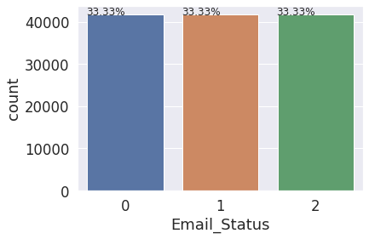
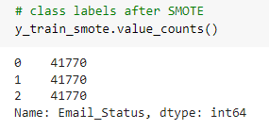
Oversampling using SMOTE :
Random oversampling involves randomly selecting examples from the minority class, with replacement, and adding them to the training dataset.
Though we do not lose any information, the shortcoming of this method is that the models train on the duplicate data for the minority class. Even though it gives better results than just training with imbalanced data, the better option is to use SMOTE.
Using KNN algorithm, SMOTE creates observations that mimic the features and behaviors of the minority classes.
Distribution of class labels for training data after oversampling :

Slide 25
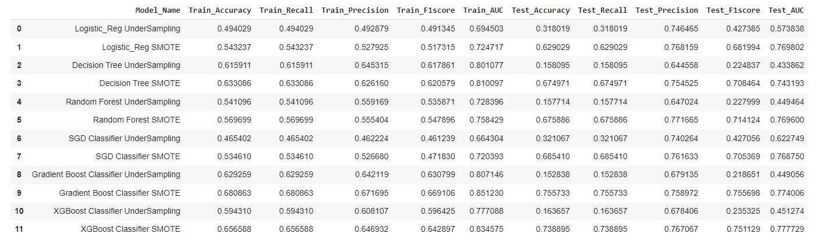
Modelling :
We trained logistic Regression, Decision Tree, SGD Classifier, Random Forest, Gradient Boost & Xgboost Classifier on the transformed training data.
We trained these models for both undersampled and oversampled data. The following data-frame shows the model results for training and testing-

Slide 26
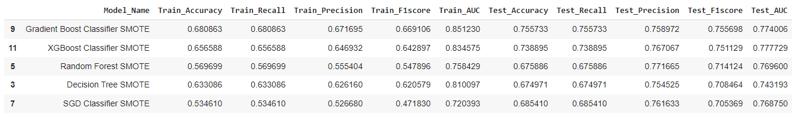
Modelling Continued :
Ensemble learning methods generally give better performances. That is what we mostly here as well.
Here are the top 5 models that had the best performances-
We can also see that all the top performing models were trained on the data that was oversampled using the SMOTE technique.
So, we can definitely say that SMOTE is doing better job compared to undersampling.

Slide 27
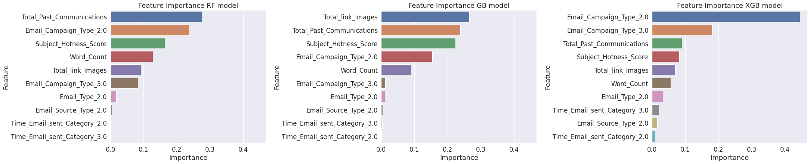
Feature Importance :
We checked feature importance for 3 ensemble models (Random Forest, Gradient Boost & XGBoost). The top most important features that we found were –
Email Campaign Type
Total Past Communications
Subject Hotness Score
Total Link Images
Word Count

Slide 28
Feature Selection :
Time Email Sent Category & Email Source Type were two of the columns that came at the last position in terms of feature importance.
The reasonable explanation can be that for the kind of data that we had, it did not really matter when the emails were sent. This did not have much of an impact on the customers’ responses.
So, we dropped these two columns from the original set of features.
Hyperparameter Tuning:
The process of selecting the best parameters to use is known as hyper-parameter tuning.
To perform this task, we used Grid Search with 3 fold cross validation. We tried out combinations of different parameters in iterations to figure out which ones give the best results.
We tuned the hyper parameters for Random Forest and Xgboost model.
Evaluation Metric : Our problem statement clearly tells us to characterize the mail and track the mail that is ignored; read; acknowledged by the reader. So, we need to make sure that false predictions are as low as possible.
For this reason, we chose F1 Score and AUC-ROC(Area Under the Curve-Receiver Operating Characteristics) Score. Both F1 and AUC-Roc score becomes low if our model keeps making wrong predictions. As these scores get closer to 1, we can be confident that our model is being able to distinguish different classes better.

Slide 29
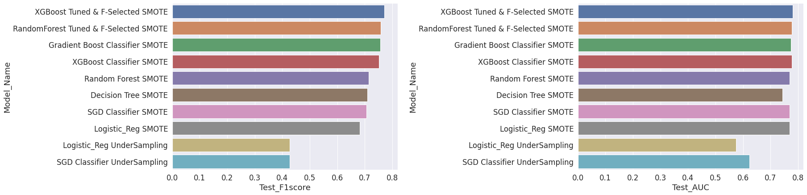
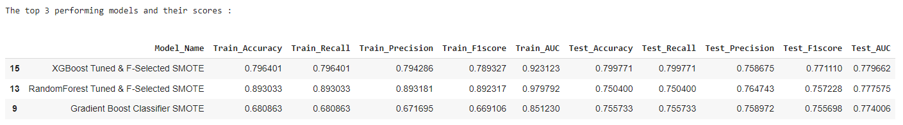
Model Performance after Hyperparameter Optimization :
Top 3 Best Performing Algorithms :

Slide 30
Conclusion :
Email campaign is a very popular and effective way of marketing. It can help converting potential clients, sustaining old clients and most importantly it leaves room for experimentations. Being able to understand a customer's preference and consumer habits can help build a long-term relationship and trust between a brand and the customer. So, it becomes crucial for a business to figure out the Do's and Don'ts to provide a decent experience.
In this project, we tried to find out exactly those factors that influence the effectiveness of marketing through Email campaigns. Here's the summary of what we found -
Observations :
Exploratory Data Analysis :
This is the step of understanding the data using various statistics and visualizations and draw business insights. During the EDA, we found-
The demographic of potential clients does not have an influence on that person ignoring, reading or acknowledging to email campaigns. We noticed that the distributions for the client's response remains more or less similar regardless of where the person lives. For the data that we have, it is wise to not consider Customer Location as an influencing factor.

Slide 31
Conclusion…
Email Campaign Type 1 was sent the least number of times which had the best probability of being read and acknowledged. Email Campaign Type 2 was sent most and it was ignored the most.
The time of day when the email was sent does not have much of an impact on the response that was received. We found that during the feature importance evaluation as well.
There were outliers for all the numeric columns except for Word count column.
Total communications made prior is a very important factor to consider if we want to avoid emails being ignored. It was observed that, more the businesses kept in touch with the potential customers, the chances of the next emails being read and acknowledged increased.
The emails with lower Subject Hotness Score were read and acknowledged more.
Emails with high number of links and images were ignored more. It is better to keep that in check.
Emails that were too lengthy, have a higher chance of being ignored. Hence, shorter mails are better.
Among all the numeric features, Total Images and Total Links were highly correlated. So, during the feature engineering, we merged these two columns to create a new column that would have the essence of both these columns.
Modelling Approach :
To handle the class imbalance problem, we used under sampling and oversampling both.
We used SMOTE (synthetic Minority Oversampling Technique) for oversampling as it creates synthetic data for the minority classes instead of simply just copying the existing observations.

Slide 32
Conclusion…
We noticed that in every case, Machine Learning models with SMOTE outperformed the under-sampling methods.
Since we were having some outliers for the minority class, we decided to use more tree based and ensemble learning algorithms to mitigate the impact of outliers as much as possible.
We checked and compared the feature importance for 3 different ensemble models and discarded the two of least contributing features. These two features were 'Time Email Sent Category' and 'Email Source Type'.
We boosted the model performance for Random Forest and XGBoost model, performing hyper-parameter tuning with grid search and cross validation.
Model Selection :
Hyper-parameters tuned XGBoost model with the most relevant features selected performs the best. It has the F1 Score of 0.77. The Accuracy, precision and Recall scores are also overall better for this model.
At 2nd & 3rd, we have Gradient Boost and Random Forest Model with feature selection.

Slide 33
Thank You

